Slide 1
Industria…Digitalizzazione…. IoT.......
”Scusi: ma per andare dove dobbiamo andare, per dove dobbiamo andare?”
Auditorium ABB di Sesto S. Giovanni (MI)
19 aprile 2017
Visione ed applicazione della trasformazione digitale nel Power Generation: l'approccio Ansaldo Energia
Luca Manuelli
Chief Digital Officer and
SVP Quality, IT and Process Improvement

Slide 2
AGENDA
20 Years Ago: Ariston Digital
Today: Ansaldo 4.0
New And Old Internet of Things: Key Similarities and Differences

Slide 3
AGENDA
20 Years Ago: Ariston Digital
Today: Ansaldo 4.0
New And Old Internet of Things: Key Similarities and Differences

Slide 4
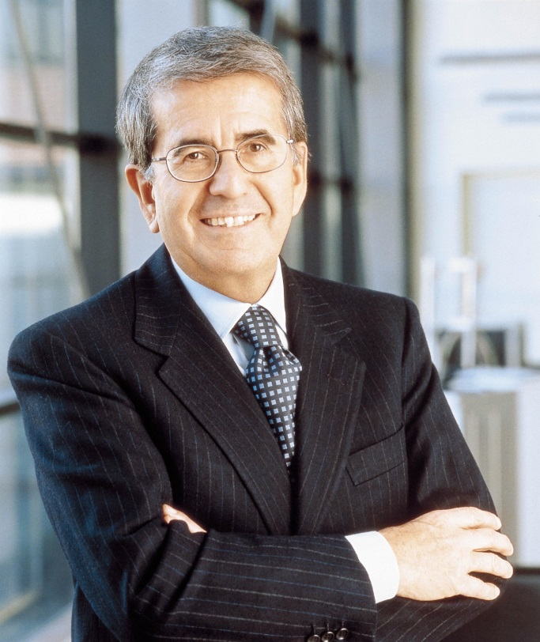
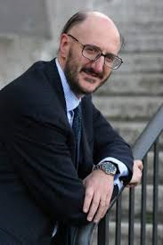
1997

Slide 5
1997
MARKET SCENARIO: INCREASING COMPETITIVENESS
MANUFACTURERS: OEM vs NO NAMES
CHANNELS: GDO PRICING PRESSURE AND CUSTOMERS’ OWNERSHIP
CUSTOMERS: MORE VALUE FOR LESS MONEY
NEW DIGITAL TECHNOLOGIES SCENARIO:
INTERNET (OF THING)
COMMUNICATIONS (BY POWER LINE)
ENABLERS OF NEW ADDED VALUE SERVICES
ARISTON DIGITAL:
INTEGRATED PRODUCT + SERVICE VALUE PROPOSITION ENABLED BY THE DIGITAL TECHNOLOGY

Slide 6
System Architecture and Key Services
Smart Appliances
Powerline
Meter
Leon@ardo
WRAP ( Web Ready Appliance Protocol)
Power Management
Local Control
Tele-assistence
Remote Control
ADSL
Portale Web
Contact Center Contact Center

Slide 7
margherita2000.com
The 1st digital washing machine linked to the cellular telephone network and to the Internet

Slide 8
Leon@rdo
Home Tablet as Domotic User Interface for WRAP web-based services (e-cooking, smart fridge, etc.)

Slide 9
AGENDA
20 Years Ago: Ariston Digital
Today: Ansaldo 4.0
New And Old Internet of Things: Key Similarities and Differences

Slide 10
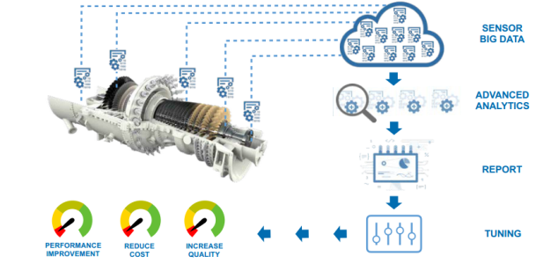
More than 160 Years Background
ANSALDO 4.0
Global leading OEM of GT and ST
Acquisition of Alstom advanced HDGT technology and Assets Acquisition of Power System Manufacturing
TODAY
2016
Incorporation of Joint
Ventures with Shanghai Electric Company
2014
1853
Giovanni Ansaldo
& Co. established
100 years of
Steam Turbine manufacturing
2012
1923
First Power Plant
150th Gas Turbine manufactured
2010
1962
First supercritical
600 MW Power Plant
OSP™
concept launch
2007
1991
Ansaldo Energia
established
2005
1995
First Combined Cycle Power Plant
based on Ansaldo Energia GT
Total Technological Independence

Slide 11
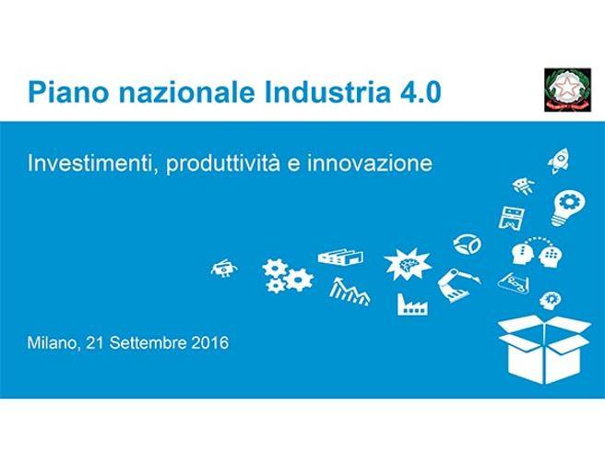
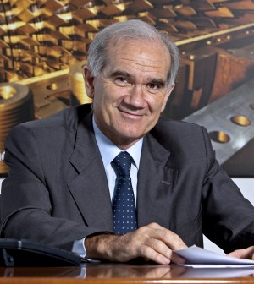
2017: ANSALDO 4.0

Slide 12
AGENDA
20 Years Ago: Ariston Digital
Today: Ansaldo 4.0
New And Old Internet of Thing: Key Similarities and Differences

Slide 13
New And Old Internet of Things: Key Similarities and Differences
After 20 years from Ariston Digital – first Industrial IoT experience – the Integrated Product+Service Value Proposition enabled by the Digital Technology is again the key strategic driver of the Ansaldo Energia 4.0 vision in the current Industria 4.0 scenario.
Ariston Digital leveraged mainly on new web technology developed in USA (i.e. Medialab/MIT of Negroponte, IDEO Design) but with a well qualified even if limited R&D italian support (Merloni Labs managing household appliances electronics).
Digital Technologies enabling Ariston Digital (WRAP, margherita2000.com and the other smart appliances, Leon@ardo) not enough mature for a full exploitation in the mass market ➔ partial valorisation addressed the USA Appliance Service Business (WRAP technology sold to SEARS)
Ansaldo Energia 4.0 today leverage on a set of mature Digital Technologies enabling a wider application along its whole value chain.
Many of the innovating 4.0 applications have beeing developed by Italian know-how supported by leading edge Competence Centers (i.e. IIT Genova, Sant’Anna Pisa).
The full potentiality of application of Digital Technology can support Ansaldo Energia to increase its competitiveness (performance, quality, cost, time-to-market) as well to develop new business model delivering new added value services to its customers.
Role of visionary and charismatic leaders (V. Merloni and F. Caio 20 years ago; G. Zampini today) as well change and digital skills gap management are key factors of success.
Industry 4.0 is an evolution and not a revolution in AEN 4.0 vision

Slide 14
Technology is not a gadget !!!!

